Slide 1



Anderson vs Anderson
Filmography vs Filmography

Slide 2
Paul Thomas Anderson
Releasing features since 1996
First feature was the film Hard Eight staring Philip Baker Hall, John C. Reily, and Gweneth Paltrow
Has released 9 features in total, with his tenth film, One Battle After Another, being released later this year
First notable success was Boogie Nights, his second feature released in 1997
His most successful project was There Will Be Blood staring Daniel Day-Lewis, a frequent collaborator, in 2007

Slide 3


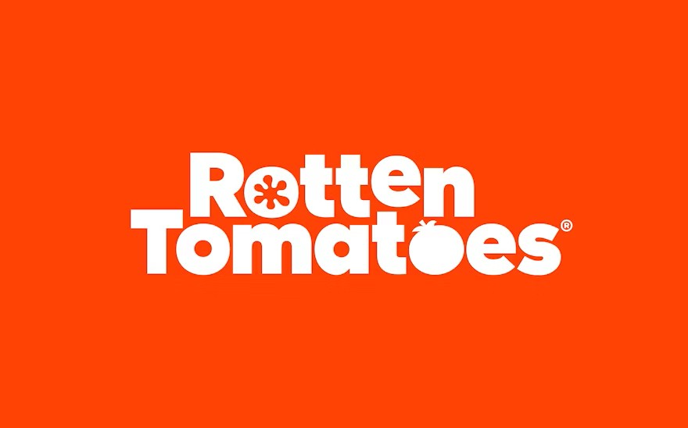
Paul Thomas Anderson
The Movie Database
Average rating of 6.97 on their website
There Will Be Blood has the highest rating at 8.1
Inherent Vice has the lowest rating at 6.6
International Movie Database (IMDb)
Average rating of 7.1
There Will Be Blood (8.2) and Inherent Vice (6.6) strike again as his highest and lowest rated movies
Rotten Tomatoes
Fairly large difference between average critic (8.53) and average audience (7.5)
Boogie Nights beats out There Will Be Blood with a critic score of 9.4 and ties Magnolia as his two highest audience scored films, both at 8.9
Inherent Vice again sits at his lowest critic (7.4) and audience (5.3)

Slide 4
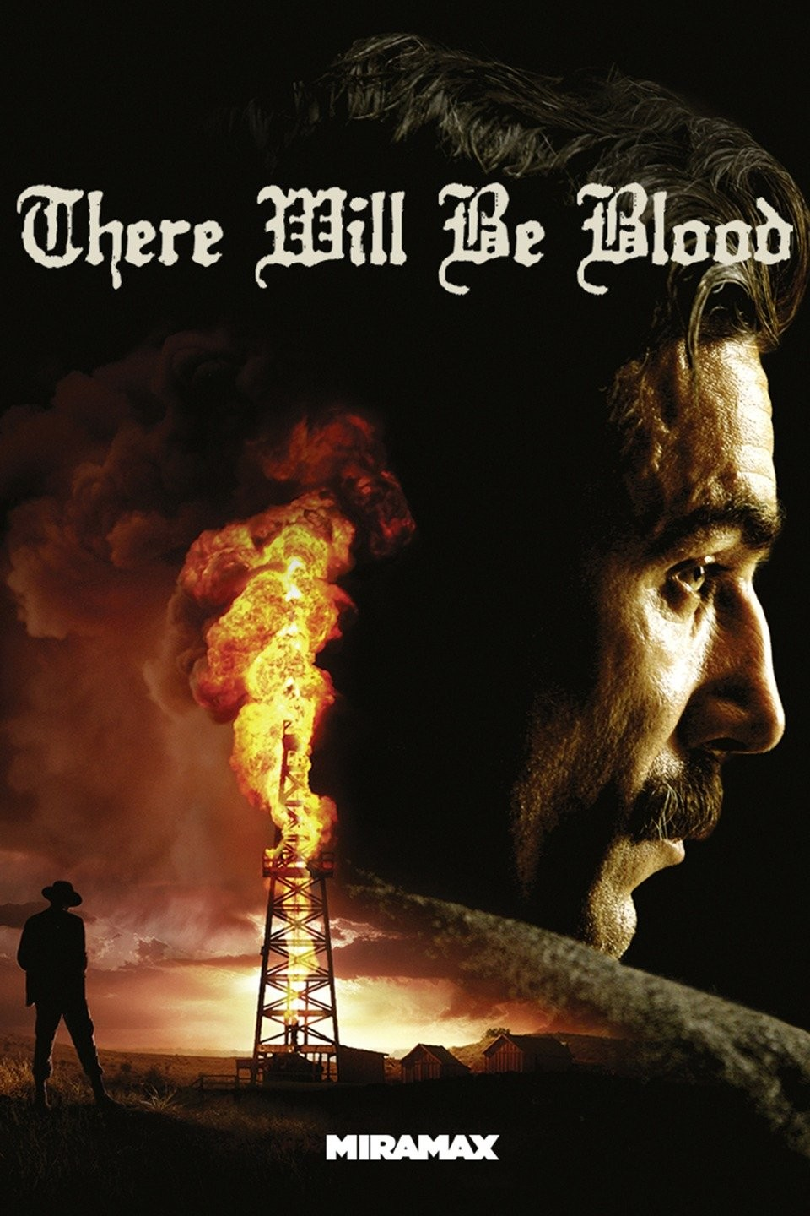
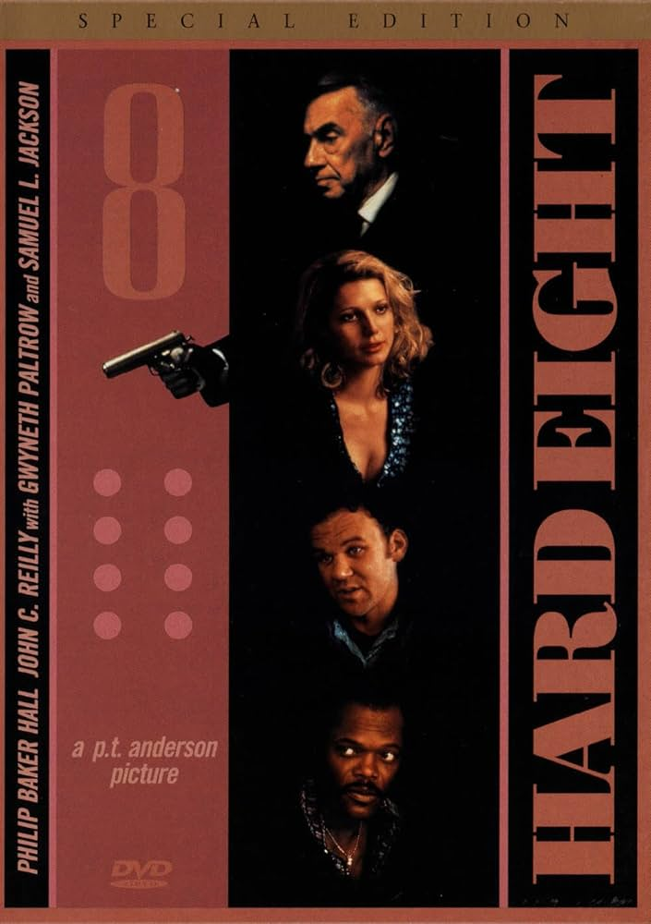
Paul Thomas Anderson
Box Office
Has earned a total of $170 million across his 9 films
His average box office return is $18.85 million
There Will Be Blood has the highest box office return at $40.2 million
Hard Eight has the lowest at $215.6 thousand
Actors
Has worked with many actors and incredible ensembles across his 9 films
He has many frequent collaborators:
Philip Seymour Hoffman, Daniel Day-Lewis, Joaquin Phoenix, and Julianne Moore
Hoffman has appeared in the most of his films: Hard Eight (uncredited), Boogie Nights, Magnolia, and The Master.
Notes:
Mention I am only focusing on the first 5 actors in the credits of each of his films in this data set.

Slide 5
Wes Anderson
Began releasing feature films in 1996
First film was Bottle Rocket staring Luke and Owen Wilson
His first notable success was the 2001 film, The Royal Tenenbaums
His most successful film is The Grand Budapest Hotel which released in 2014 that stared a huge ensemble cast including Ralph Fiennes, Adrien Brody, and Willem Dafoe
He has released 11 feature films, 9 being live action and 2 being animated; his 12th feature film, The Phoenician Scheme, releases later this year

Slide 6
Wes Anderson
The Movie Database
Has an average rating of 7.29
International Movie Database (IMDb)
Has an average rating of 7.42
Rotten Tomatoes
Only has a hundredth of a difference between his average critic score (8.20) and average audience score (8.19)
The Grand Budapest Hotel has the highest at 8.0
Bottle Rocket has the lowest rating sitting at 6.2
The Grand Budapest Hotel again with the highest at 8.1
Asteroid City sits with the lowest at 6.4
He has a few films at 9.0+ critic score, with Fantastic Mr. Fox and Moonrise Kingdom tied at 9.3
Rushmore has the highest audience score, sitting alone at 9.1, no other film going past 8.9
His most critically-panned film is The Life Aquatic with Steve Zissou sitting at a lowly 5.7 and his lowest audience-scored film is Asteroid City at 6.2

Slide 7

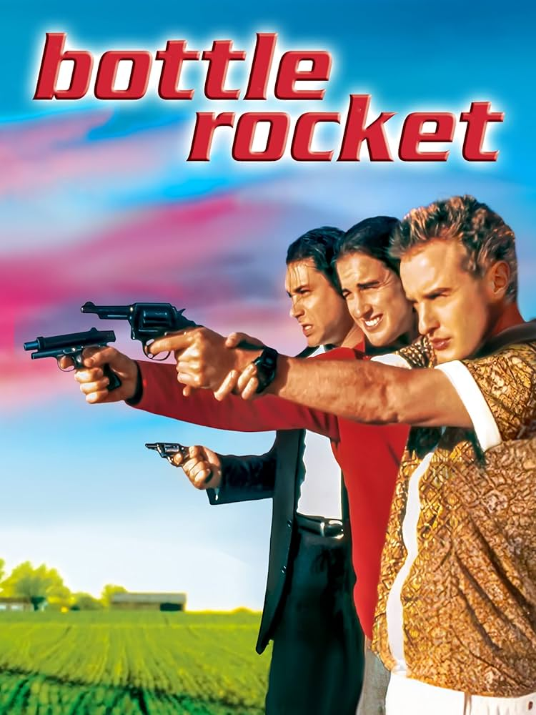
Wes Anderson
Box Office
Has earned a total of $308 million over his 11 films
Actors
Known for amazing ensemble casts across all his movies.
Taking out the animated features, he has still earned $255 million at the box office
His average box office return is $27.96 million
The film that made the most was The Grand Budapest Hotel with $59.1 million
Bottle Rocket made the least with $488.6 thousand
Frequently collaborates with Bill Murray, Jason Schwartzman, Adrien Brody, Owen Wilson, and Edward Norton
Murray and Schwartzman appear in the most of his films
Notes:
Mention I am only focusing on the first 5 actors in the credits of each of his films in this data set.

Slide 8
Anderson vs Anderson
Motion Picture Association of America (MPAA)
Paul Thomas Anderson’s films are all rated “R” due to the various adult themes he uses his films to explore
Drug-use, violence, sex, strong language, nudity, etc
Wes Anderson’s films are a bit more diverse when it comes to rating
He has one film that is “PG”, three that are “PG-13”, and the rest that are “R”
His various tones and style of humor and themes he likes to approach give him these more variable ratings
Amount of Films
Wes edges out Paul here with his two animated features leading to him being more prolific, however they both only have nine live-action with both releasing their tenth live-action films this year.

Slide 9
Anderson vs Anderson
Online Ratings
They’re both almost equal when it comes to ratings, especially from TMDb and IMDb
Paul has an average TMDb score of 7.26 and Wes has a 7.29 rating
Their highest rated films from TMDb only have a difference of 0.058 rating with There Will Be Blood barely edging The Grand Budapest Hotel
For IMDb, the average rating split is even less, with Paul having a rating of 7.41 and Wes having one of 7.42
There Will Be Blood beats The Grand Budapest Hotel again but by a difference of 0.1 (8.2 vs 8.1)

Slide 10
Anderson vs Anderson
Online Ratings
Rotten Tomatoes
This is the site where they have a greater difference, especially when it comes to the audience score
Paul beats out Wes critically with an average score of 8.53 vs 8.20
The audience loves Wes however, rating him on average at 8.19 versus Paul’s average audience score of 7.50
For Paul, his film Boogie Nights has a greater critic score (9.4) than any of Wes’s films
Wes also has the lowest critically-rated film with the Life Aquatic at a 5.7
When it comes to the audience, Paul doesn’t have a score above 9.0, however Wes has Rushmore, which sits at 9.1
Inherent Vice sits low at 5.3 audience score

Slide 11
Anderson vs Anderson
Box Office
Wes beats out Paul, even after taking away the two animated features to even out the film count
Wes made $255 million versus Paul’s $170 million
Wes also has three separate films that all made more than Paul’s most box office-successful feature
Moonrise Kingdom ($45.5M), The Royal Tenenbaums ($52.4M), and The Grand Budapest Hotel ($59.1M) all beat There Will Be Blood ($40.2M)
Both of their first features did make less than $500 thousand, however Wes wins here too
Bottle Rocket made $488.6K versus Hard Eight that brought in $215.6K

Slide 12






Anderson vs Anderson

